Slide 1
VBA Scripting (take 2)
Nick Anderson

Slide 2
Budget Checker (partner up, 16 min.)
Calculate the total after fees and enter the value in the "Total" cell.
Create a Message Box for the user to designate whether the amount including fees is within or over budget.
If the total is over budget, correct the price such that it fits within the max of the user's budget. Be sure to round down!

Slide 3
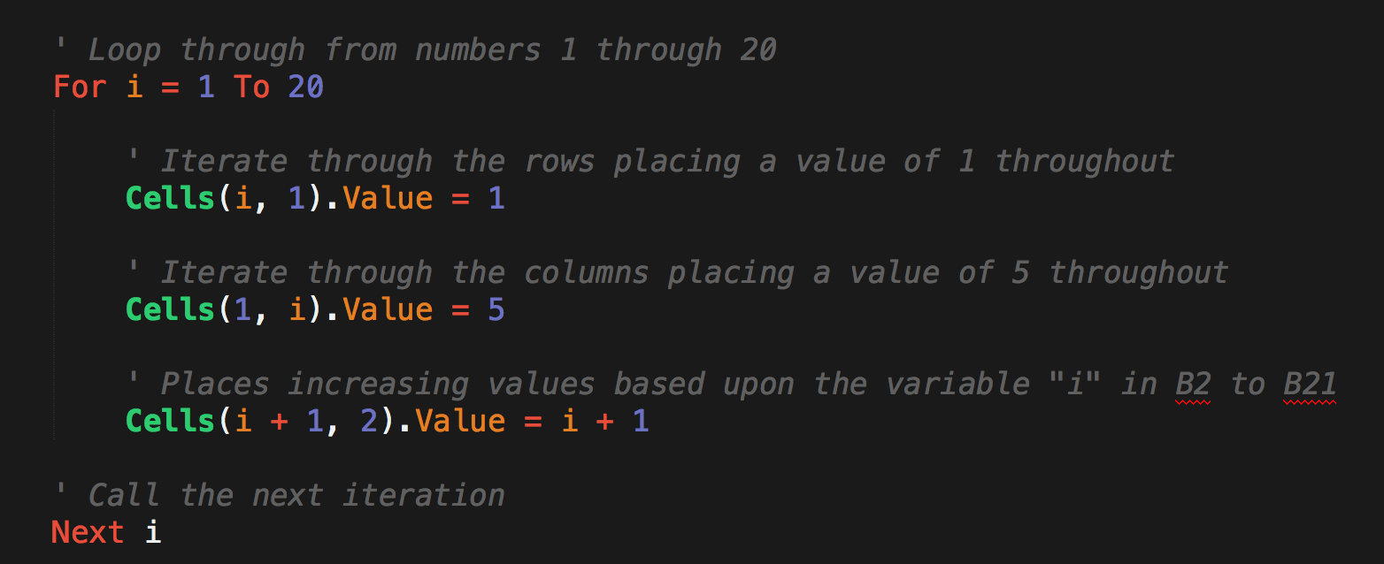
For Loop

Slide 4
(your turn, 10 min.)
A1 | B1 | C1
I will eat | 11 | Chicken Nuggets
I will eat | 12 | Chicken Nuggets
I will eat | 13 | Chicken Nuggets
I will eat | 14 | Chicken Nuggets
I will eat | 15 | Chicken Nuggets
I will eat | 16 | Chicken Nuggets
I will eat | 17 | Chicken Nuggets
I will eat | 18 | Chicken Nuggets
I will eat | 19 | Chicken Nuggets
I will eat | 20 | Chicken Nuggets

Slide 5
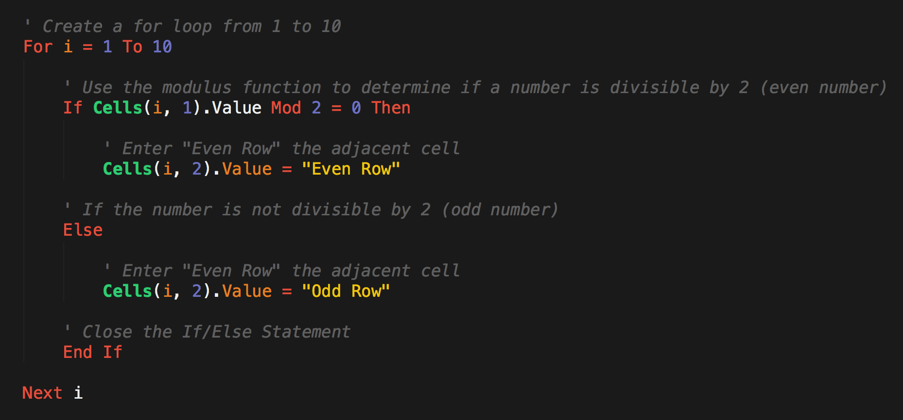
For Loop with Conditionals (remember Mod)

Slide 6
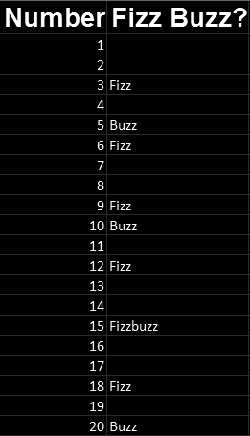
Fizz Buzz (your turn, 20 min.)
If the value in column 1 is a multiple of both 3 and 5, print "Fizzbuzz" in column 2.
If the value in column 1 is a multiple of just 3, print "Fizz" in column 2.
If the value in column 1 is a multiple of just 5, print "Buzz" in column 2.

Slide 7
Break (15 minutes)

Slide 8
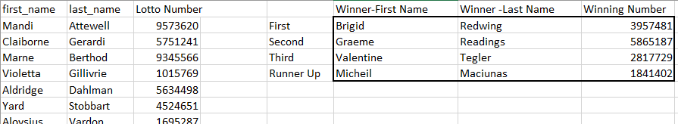
Lotto Search (partner up, 20 min.)

Slide 9
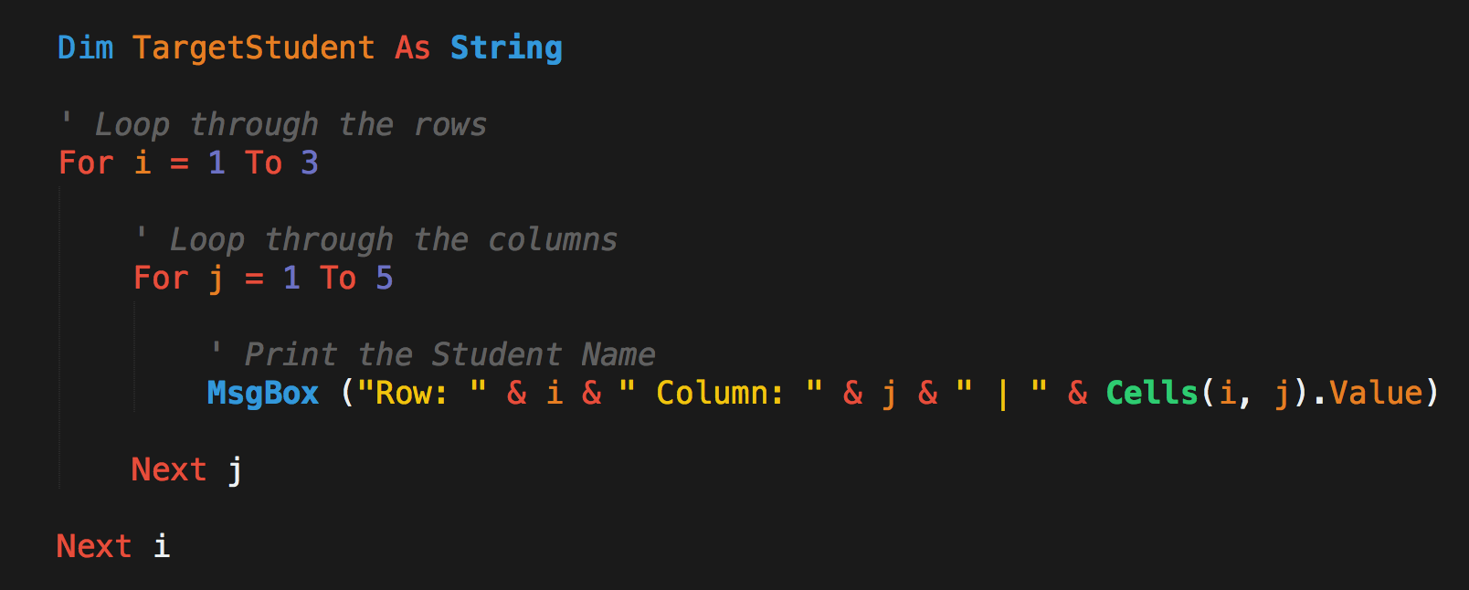
Nested For Loops

Slide 10
Hornets Nest (your turn, 25 min.)
Count the number of Hornets found and display the number to your user in the form of a message box.
Modify the script such that it changes the word Hornets to "Bugs".
Modify to use the full set of Bugs and Bees you have available to replace the Hornets with all available Bugs first then Bees. If you run out of Bugs or Bees provide the user with the message: "Oh no! We still have hornets..."

